Slide 1
Music Recommendation System Using Deep Leaning and Language Modeling
March 2022
Gaurav Garg

Slide 2
Table of Contents
What is Recommendation System
What’s Special to Music Recommendation?
History of Recommendation Systems
User-based Collaborative Filtering
Item-based Collaborative Filtering
Content-based Filtering
Deep Learning
Challenges to be encountered
Problem Statement
Dataset Description
Exploratory Data Analysis
Data Pre-processing
Proposed Solution
Cold start problem
Results and Discussion
Conclusion and Future Work

Slide 3





What is Recommendation System
Recommendation System is a information filtering technique, which provides users with information, which he/she may be interested in.
Millions of Customers with huge inventory of movies, 60-70% of views result from the recommendations
82 Million songs, more than a million user-generated playlists. Provides next song recommendation
Huge volume of collective information about user’s social and profession network, customers can view what people with similar taste viewed
Recommends customers based on their interest and what other customers with similar interest have purchased.

Slide 4
What’s Special to Music Recommendation?
01
04
Duration of items is very less
Huge magnitude of available items
02
05
Very often consumed in sequence
In contrast to movies, recommendations are often appreciated
03
Listener’s intent and context are crucial
06
Different consumption settings, headphones or stereo, alone or in group, etc.

Slide 5
History of Recommendation Systems
Collaborative Filtering (Shardanand 1994) method finds a subset of users who have similar tastes and preferences to the target user and use this subset for offering recommendations.
Assumptions:
Users with similar interests have common preferences.
Sufficiently large number of user preferences are available.
Types:
User Based
Item Based

Slide 6
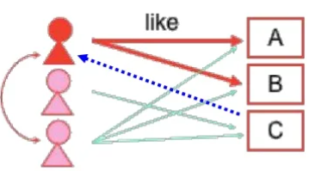
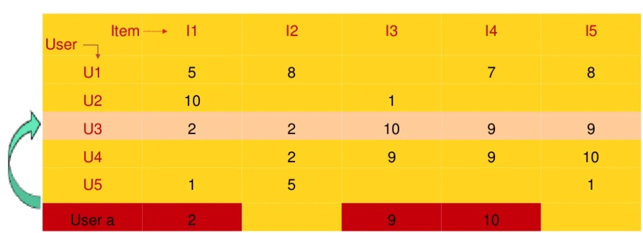
User-based Collaborative Filtering
User-item representation matrix is used
Makes user-to-user correlations
Recommend items preferred by those users

Slide 7
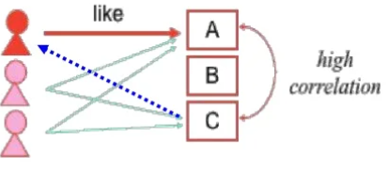
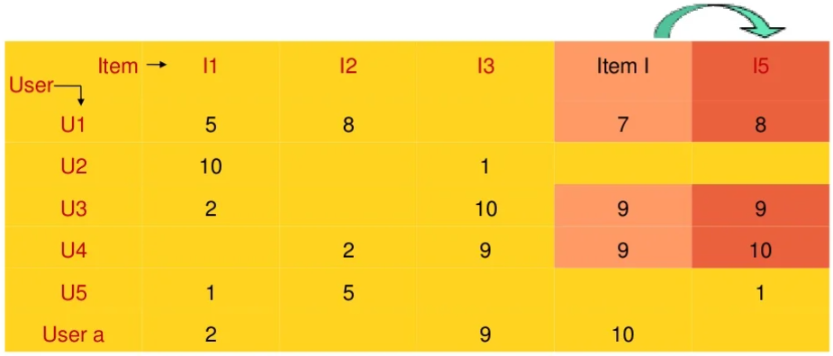
Item-based Collaborative Filtering
Also uses user-item representation matrix
Makes item-to-item correlations
Recommend items with highest correlation

Slide 8
History of Recommendation Systems
2. Content Based Systems recommend items similar to those a user has liked (browsed/purchased) in the past.
Advantages:
No need for data on other users. No cold start problem
Customers with unique taste also get good recommendations
Recommendations are interpretable
Limitations:
Unable to use quality judgements from other users.
Poor recommendations for customers who like variety of genres.

Slide 9
History of Recommendation Systems
3. Deep Learning is used in recommender systems to make use of title, artist and lyrics embeddings along with collaborative or contest-based filtering to create ensembles.
Such ensembles of deep learning models outperforms only filtering based models and give more relevant recommendations.
Some models like multimodal collaborative filtering (Yang et al., 2018) and Two-stage model (Volkovs et al, 2018) made use of CNNs for recognizing song orders and title embeddings respectively.

Slide 10

Challenges to be encountered
Evaluation Metrics
01
There is no fixed metrics to correctly compare all models
Sequential pattern
02
CNN and collaborative models cannot trap sequential nature
Transparency
03
Deep learning models are not easily interpretable
Time and resources
04
Computational cost and time associated with training large dataset is high

Slide 11
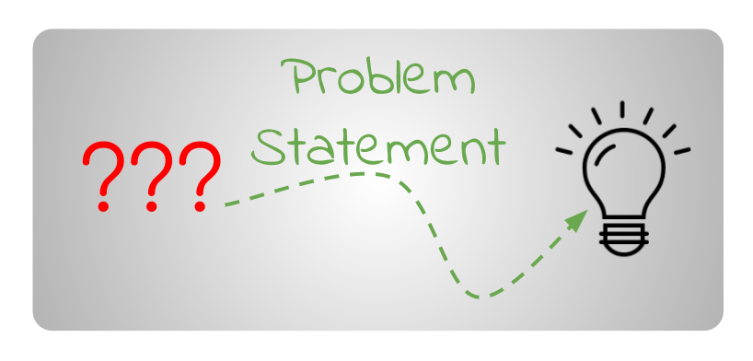
Problem Statement
Current studies do not take sequential nature of playlist into account which seems to be important. Also, there are no studies which utilizes word2vec model to solve for cold start problem (playlist just with name). Fulfilling these gaps can generate more relevant recommendations.
‘’How to recommend songs based on previous tracks in the playlist and solve for cold start problem?’’

Slide 12
Dataset Description
Spotify’s Million Playlist Dataset (MPD) was used which contains 1 million user-created playlist during Jan 2010 – Oct 2017. These playlists have 2.2 million unique tracks combined.
Attribute | Description | Type
pid | The MPD ID of this playlist is its playlist id. This is a number that ranges from 0 to 999,999. | Integer
name | This is the title of the playlist. | String
description | This is the playlist's description. Note: Because for playlist created by users, description is Spotify’s new feature, the majority having missing description. | String
modified_at | When was the last time the playlist was updated? Times are rounded to nearest hour on date the playlist was last updated, which is midnight GMT. | Timestamp
num_artists | The number of distinct artists represented in the playlist's songs. | Integer
num_albums | The total number of albums that each track in the playlist has. | Integer
num_tracks | The playlist's total amount of tracks. | Integer
num_followers | The number of people who followed this playlist when the MPD was generated. | Integer
num_edits | The total number of times playlist was edited. Tracks updated into playlist within a two-hour time frame are assumed to be part of a single edit. | Integer
duration_ms | In milliseconds, the duration of all the tracks added in playlist. | Numeric
collaborative | Whether the playlist is collaborative or not. A collaborative playlist can have tunes contributed by multiple people. | Boolean
Attribute | Description | Type
pid | The MPD ID of playlist the track belongs to. This is a number that ranges from 0 to 999,999. | Integer
track_name | The title of the song. | String
track_uri | The track's URI on Spotify. | String
album_name | The album's name is the title of the track. | String
album_uri | The album's URI on Spotify. | String
artist_name | The major artist on the track's name | String
artist_uri | The primary artist's Spotify URI for the track. | String
duration_ms | The track's duration in milliseconds | Numeric
pos | The track's position on the playlist. | Integer

Slide 13
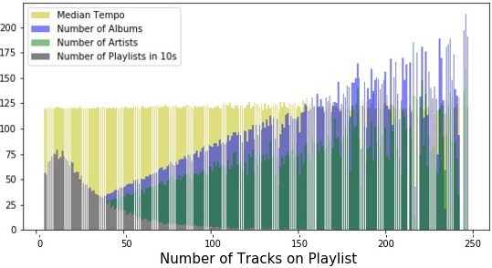
Exploratory Data Analysis
Number of albums and artists in the playlists increase with number of tracks in the playlists.
Number of playlists with certain number of tracks in playlists forms maxima at around 20 tracks.
Median tempo in playlist has no linear trend with number of tracks in playlists.

Slide 14
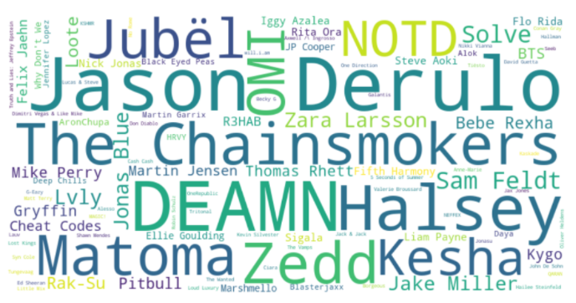
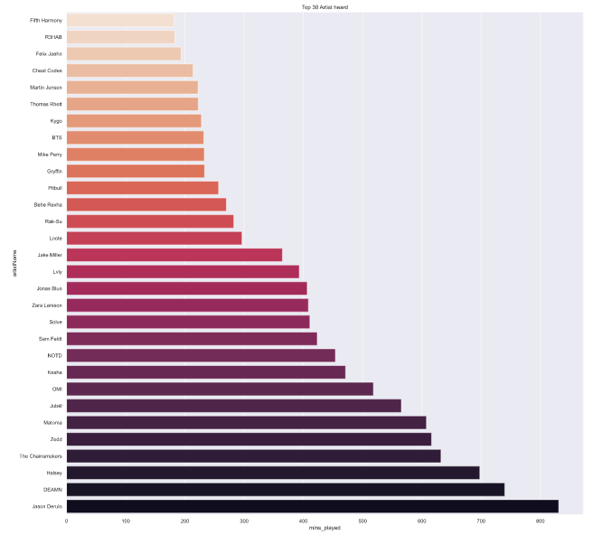
Exploratory Data Analysis
Word cloud shows the top 100 artists, artists with highest number of playlists containing their tracks.
If we look at the count of playlists containing their tracks it is 450k maximum and the top 50th has around 150k playlists.
Songs from these artists will be preferred for cold start problems.

Slide 15
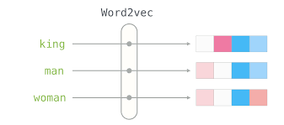
Data Pre-processing
Textual features like track title, artist name, playlist name, etc. are processed using word2vec embedding.
After forming separate embeddings for each, they are concatenated into a single matrix to be used as input for our model.

Slide 16

Proposed Solution
Predicting next song is quite similar to predicting next word in the sentence in language modelling.
RNNs with Cross entropy loss function is considered to solve for automatic playlist completion in this study.
Optimizer, number of hidden layers and number of steps were tunned for best fit model.
Algorithm proceeds with following steps for every sequence
Calculate log odds (logits) for every seed in the sequence
Combine all log odds by taking average
Rank tracks according to their log odds score.

Slide 17
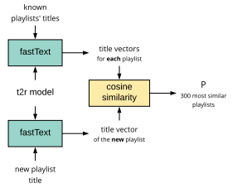
Cold start problem
For playlist without any tracks and just the name of the playlist, we trained a title2rec model which finds songs based on cosine similarity between playlist names.
A title vector is formed by words to vector transformation.

Slide 18
Results and Discussion
Adam Optimizer with 1 epoch performs better than rest.
These results are from models trained on training dataset with 10000 playlists only due to resource limitation.
On increasing number of playlists in training dataset, the model performance kept on increasing.
Model is not performing as per standards of state-of-the-art models.
Optimizer | Epoch | R-Prec | NDCG | Click
Gradient | 1 | 0.1417 | 0.1621 | 4.2012
Gradient | 2 | 0.1500 | 0.1678 | 3.9435
ADAM | 1 | 0.1572 | 0.1718 | 3.9522
ADAM | 2 | 0.1532 | 0.1699 | 4.1342
Model | R-Precision | NDCG | Click
Two-stage model CNN + Collaborative filtering (Volkovs et al., 2018) | 0.2241 | 0.3946 | 1.7839
Multimodal Collaborative Filtering CNN + encoders (Yang et al., 2018) | 0.2234 | 0.3932 | 1.8952
Hybrid model with LightFM + xgboost (Rubtsov et al., 2018) | 0.2153 | 0.3846 | 1.7818

Slide 19
Conclusion and Future Work
Word2vec and RNN models are complementing each other well.
Our model is able to capture sequential patterns in the dataset.
Model is tested on 10 different types of set of playlists.
Since computation time for training RNN is high, we can train model on larger dataset with higher computation power.
Model should also take into account number of times a track appears in the playlists.
Lyrics of songs can be further utilized to do sentimental analysis.

Slide 20
THANK YOU

